Slide 1

Department of Computer Science & Engineering
Project Phase 1 Presentation on
“Using facial landmarks to detect drowsiness”
Batch Number: 27
Kothapalli Bhargava Avinash 19BTRCS035
Vellala Harshith 19BTRCS083
Srikar Koushik Satya Viswanadha 19BTRCS103
Akash P 17BTRCS114
Under the guidance of
Prof. Rajesh A
Dept of CSE, Batch 2019-2023

Slide 2
Contents
Abstract
Objective and Methodology
System Design And System Architecture
Activity diagram
Use case Diagram
Data Flow
Sequence Diagram
Hardware/Software Requirement
References

Slide 3
Abstract
Drowsiness is a common condition that can have serious consequences, particularly when it occurs while driving or operating heavy machinery. In this project, we propose a method for detecting drowsiness in real-time using facial landmarks. The proposed method involves training a Haar cascade algorithm to detect faces in video streams captured by a webcam. The detected faces are then fed into the dlib library to extract a set of facial landmarks, including the locations of the eyes.
The locations of the eyes are used to calculate the Eye Aspect Ratio (EAR), which has been shown to be a reliable indicator of drowsiness. By continuously monitoring the EAR of a person's eyes, our method is able to detect drowsiness in real-time and provide an alert to the user if necessary. This method can be used in various applications, such as driver drowsiness detection, to improve safety and efficiency.
Dept of CSE, batch 2021-22

Slide 4
Objective
Design a real-time system using image processing to capture person’s eye state.
Develop an algorithm to analyze the interval of eye closure and detect the drowsiness in advance.
Warn the person using sound alerts and increase the intensity as time passes.
Design the system in a non-intrusive way so that the person doesn’t feel uncomfortable.
To increase the accuracy of the model to develop it further so that it can be used in real-time scenarios

Slide 5
Methodology
The proposed method consists of three main steps: face detection, facial landmark extraction, and EAR calculation.
1. Face detection:
The first step is to detect the face in the input image or video frame. For this, we are training Haar cascade algorithm on a large dataset of faces. Haar cascade algorithm is a machine learning-based method that uses positive and negative samples of faces to learn the features and patterns that distinguish a face from other objects in the image.

Slide 6
The trained Haar cascade algorithm is then used to detect faces in the input image or video frame by sliding a window across the image and calculating the probability of the window containing a face.
2. Facial landmark extraction:
Once the face is detected, the next step is to extract the facial landmarks. For this, we use the dlib library, which is a popular open-source tool for facial landmark detection. The dlib library uses a pre-trained model that is trained on a large dataset of faces to detect 68 facial landmarks on the face. These landmarks are used to identify and track specific points on the face, such as the eyes, nose, mouth, and chin.

Slide 7
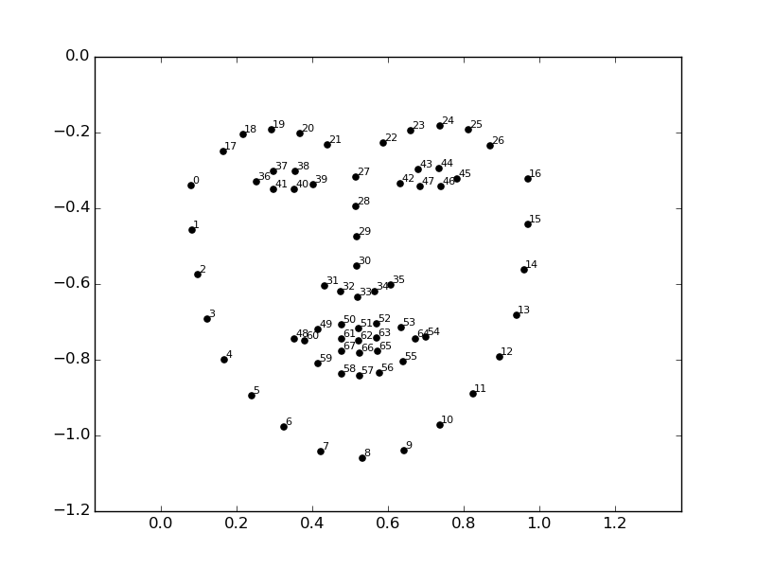

Slide 8
3. EAR calculation:
The final step is to calculate the Eye aspect ratio (EAR) of the eyes using the extracted landmarks. The EAR is defined as the ratio of the distance between the eyes and the width of the eyes. A low EAR value indicates that the eyes are closed or narrowed, which is a sign of drowsiness. The EAR is calculated using the following formula:
EAR = (A + B) / 2C
where A, B, and C are the distances between the eyes and the width of the eyes.

Slide 9
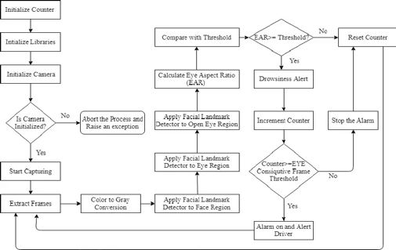
System Design And System Architecture

Slide 10
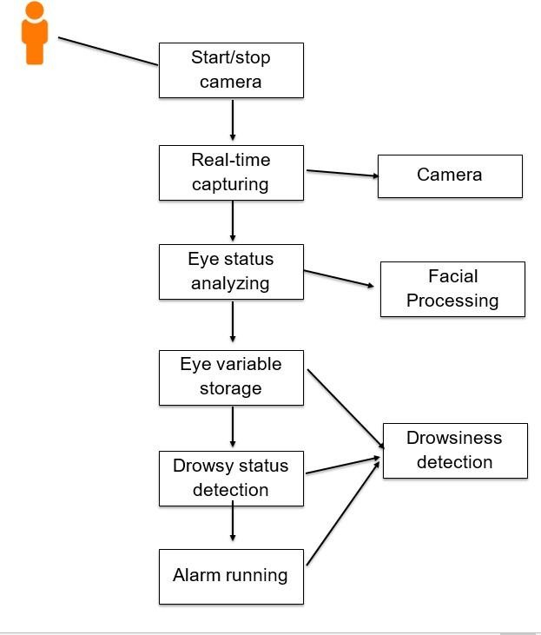
Use Case

Slide 11
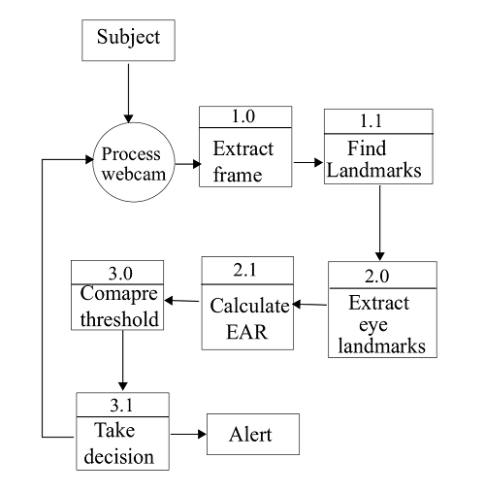
Data flow diagram

Slide 12
Data flow diagram is divided into 3 levels. The data from the entity flows through different processes to get results. The model is considered as a process which is divided into 3 different subprocesses input extraction, data processing and Decision taking.
Input extraction contains of opening web cam and capturing frames of the user and finding landmarks on the captured frame. In the second stage known as data processing here the trained model comes into the picture it extracts eye landmarks from the mapped facial marks and calculates the Eye Aspect ratio with above mentioned formula. The final part is Decision taking in the process the calculated EAR ratio is compared to the threshold ration and decision is taken weather the person is drowsy or not and based on that user will be alerted.

Slide 13
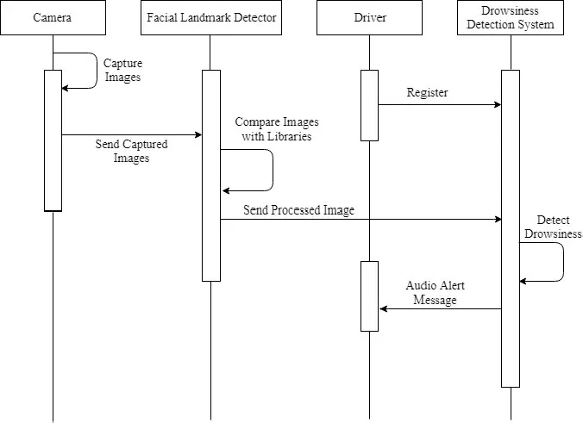
Sequence diagram

Slide 14
Obtain a video feed from a camera that is pointed at the user's face. This can be done using a webcam or a dedicated camera that is mounted in a suitable location.
Use the dlib facial landmark detector to identify the coordinates of the user's eyes in each frame of the video feed. This facial landmark detector is a machine learning model that has been trained to identify specific points on the face, including the eyes, nose, and mouth.
Calculate the eye aspect ratio for each frame by dividing the distance between the coordinates of the user's eyes by the distance between the horizontal and vertical axes of the user's eyes. This eye aspect ratio is a measure of how open or closed the user's eyes are, and can be used as an indication of drowsiness.
Continuously monitor the eye aspect ratio for each frame and compare it to a predetermined threshold value. This threshold value can be determined through experimentation or by using established guidelines for detecting drowsiness.

Slide 15
If the eye aspect ratio falls below the threshold value, it indicates that the user may be drowsy and an alert should be triggered to alert the user to take a break. This alert can be a visual or audible notification, or both, depending on the implementation.
If the eye aspect ratio remains above the threshold value, the user is considered to be alert and the process continues with the next frame of the video feed.
Repeat this process until the user is no longer in front of the camera or the monitoring is stopped. This allows the system to continuously monitor the user's drowsiness levels and provide timely alerts to prevent accidents or other adverse effects of drowsiness.

Slide 16
Hardware/Software Requirement
 | Hardware | Software
Developers | 1. 8 GB RAM 2. 256 GB Storage 3. Intel i5 5th Gen + Processor 4. Camera (which can process 30fps) | 1. Anaconda or Python 2. Pycharm IDE 3. Open Cv, Harr cascade 4. Dlib , Pygame
Users | 1. Mobile / Laptop 2. Camera (Which can process 30 fps)

Slide 17
References
[1] Jianhua Shen, Joseph Barbera, and Colin M Shapiro. Distinguishing sleepiness and fatigue: focus on definition and measurement. Sleep medicine reviews, 10(1):63–76, 2006.
[2] KP Yao, WH Lin, Chiung-Yao Fang, Jung-Ming Wang, Shyang-Lih Chang, and Sei-Wang Chen. Real-time vision-based driver drowsiness/fatigue detection system. In Vehicular Technology Conference (VTC 2010-Spring), 2010 IEEE 71st, pages 1–5. IEEE, 2010.
[3] Mandalapu Sarada Devi and Preeti R Bajaj. Driver fatigue detection based on eye tracking. In Emerging Trends in Engineering and Technology, 2008. ICETET’08. First International Conference on, pages 649–652. IEEE, 2008.
[4] Wenhui Dong and Xiaojuan Wu. Fatigue detection based on the distance of eyelid. In VLSI Design and Video Technology, 2005. Proceedings of 2005 IEEE International Workshop on, pages 365–368. IEEE, 2005.

Slide 18
[5]Liling Li, Mei Xie, and Huazhi Dong. A method of driving fatigue detection based on eye location. In Communication Software and Networks (ICCSN), 2011 IEEE 3rd International Conference on, pages 480–484. IEEE, 2011.
[6] Wen-Bing Horng, Chih-Yuan Chen, Yi Chang, and Chun-Hai Fan. Driver fatigue detection based on eye tracking and dynamk, template matching. In Networking, Sensing and Control, 2004 IEEE International Conference on, volume 1, pages 7–12. IEEE, 2004.
[7] Weiwei Liu, Haixin Sun, and Weijie Shen. Driver fatigue detection through pupil detection and yawing analysis. In Bioinformatics and Biomedical Technology (ICBBT), 2010 International Conference on, pages 404–407. IEEE, 2010.
[8] Zutao Zhang and Jiashu Zhang. A new real-time eye tracking for driver fatigue detection. In ITS Telecommunications Proceedings, 2006 6th International Conference on, pages 8–11. IEEE, 2006.

Slide 19
[9] Ang Liu, Zhichao Li, Lang Wang, and Yong Zhao. A practical driver fatigue detection algorithm based on eye state. In Microelectronics and Electronics (PrimeAsia), 2010 Asia Pacific Conference on Postgraduate Research in, pages 235–238. IEEE, 2010.
[10] Fei Yang, Xiang Yu, Junzhou Huang, Peng Yang, and Dimitris Metaxas. Robust eyelid tracking for fatigue detection. In Image Processing (ICIP), 2012 19th IEEE International Conference on, pages 1829–1832. IEEE, 2012.
[11] Haisong Gu, Qiang Ji, and Zhiwei Zhu. Active facial tracking for fatigue detection. In Applications of Computer Vision, 2002. (WACV 2002). Proceedings. Sixth IEEE Workshop on, pages 137–142. IEEE, 2002.

Slide 20
Thank You

